Slide 1
18CSC302J-Computer Networks Project
Network Design Proposal for Bank
RA2011003011121 Charvee Rathod
RA2011003011138 Divyansh Joshi
RA2011003011142 Kankana Majumder
RA2011003011149 Bhanu Pratap Singh
RA2011003011183 Sutirtha Chattopadhyay

Slide 2
ABSTRACT
A network proposal has to be developed for a bank. The bank has a main office , which is
located in Chennai, and has 5 branch offices located at Coimbatore, Madurai, Trichy, Salem
and Thirunelveli. The bank has an application server, which is used by it’s customers across
the world for online transactions. All the branches have high speed internet connection. There
are approximately 50 users in each of the branch offices and 100 users in the main office.

Slide 3
INTRODUCTION
The general aim of this project is to simulate a banking system which is secure and easy to use. Previously the system was manual, not secure, also working slowly. This proposed system overcomes the lacking of the existing manual system. All branches of the Bank situated at District level provide the Banking services to customers and had to send report to the central branch manually, which sometimes creates problem to get, up-to-date information rapidly.

Slide 4
OBJECTIVE
1. Identify the hardware components required to setup the network for the Bank
2. High availability should be available to the application server, which is accessible using https protocol.
3. The application server should be setup in a secure manner with network and host level protection.
4. All traffic into the application server should be scanned for security attacks.
5. IP network design for the branch and main offices.
6. IP addressing range for users and hardware components.
7. The users at different locations should be able to access each other, including the application server.
8. Identify the features and methodology which would be followed to achieve the solution.

Slide 5
REQUIREMENTS
Hardware Requirements:
End user devices-Pc’s, laptops. 2.Router
3.Modem 4.Firewall 5.Ethernet cable 6.Server
7.Switch
Software Requirements:
Cisco Packet Tracer

Slide 6
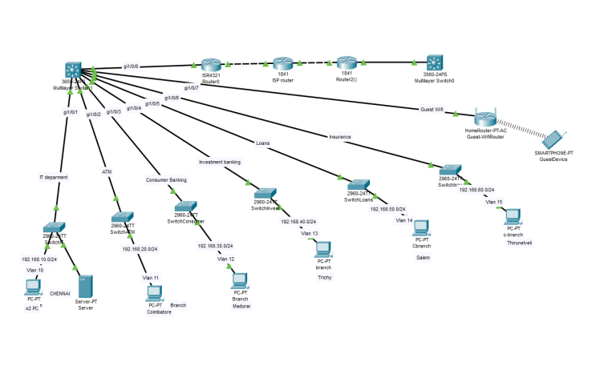
Network Topology Diagram

Slide 7
Feature and Services
1. VLAN
Two networks are required at the main office. One network would be for the LAN, where the offices users would be connected. The second network would be the DMZ network, where the application server is hosted. This is required since the application server would require access from outside. Two VLANS would be created which would be mapped with the LAN and DMZ network. VLANS would be configured on the Switches.
2. Access control lists.
Access control lists are configured on the VPN appliance at the main office. The ACLs are used to restrict communication from the internet to only the allowed port, which is TCP port 443 on the application server in the DMZ. ACL is also configured to allow all traffic from the branch office networks to the DMZ and LAN network in the main office.

Slide 8
Feature and Services
3. Static NAT
Static NAT is configured on the VPN Appliance to allow traffic from the public IP address of the application server, to the LAN IP address.
4. Failover cluster Failover cluster is configured on the Windows 2008/2012, on which the application server is hosted. This would ensure that high availability is provided to the application.

Slide 9
Conclusion
Now a days, technological development, and automated system development is more essential and crying need for the expansion of banking services because They will need less employers by using automated system. On top of that Security is a major issue regarding banking issues. With this system network will be easier to handle and it will route the data in a shortest path in a vast distributed system. In future we will try to implement it in real life so that banks can use it and get benefited from this project. The main goals are to optimize the network resources, to give security and to provide real-time users monitoring, to avoid time-wasting. As a result of this work, the solution implemented can be changed according to current organization requirements. This is especially useful because the workstations can be easily

Slide 10

THANK YOU

